Slide 1
Concept Attainment
Body Systems

Slide 2

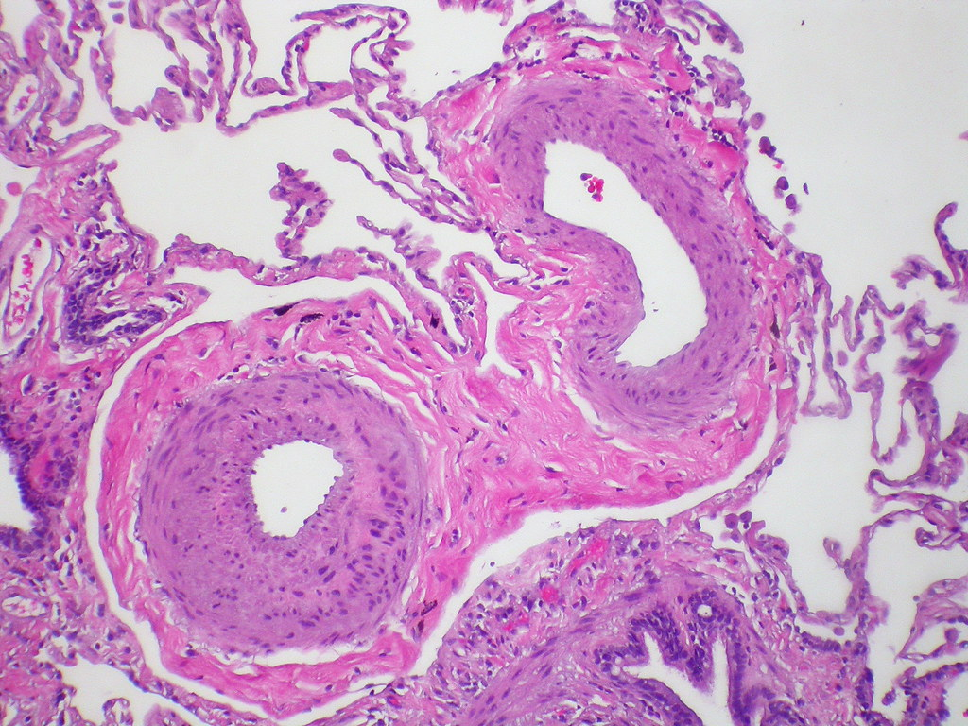
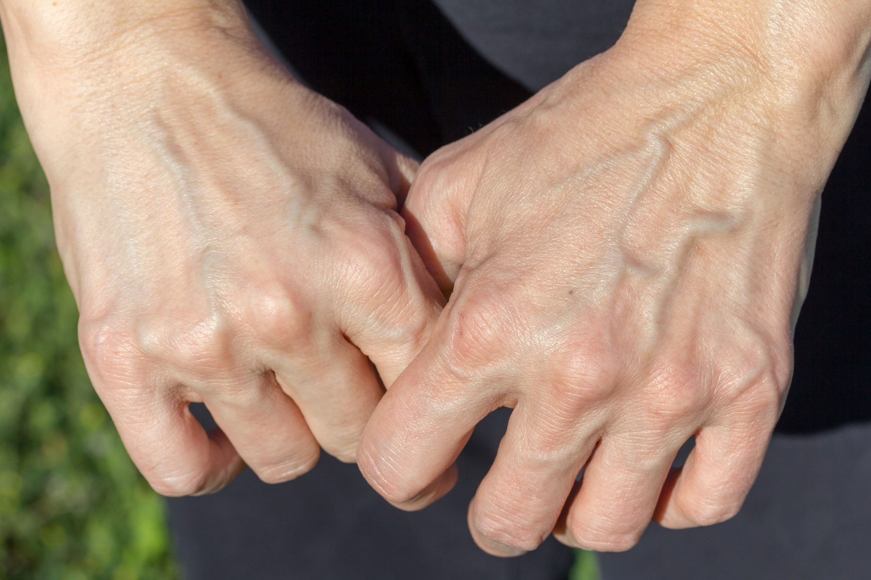
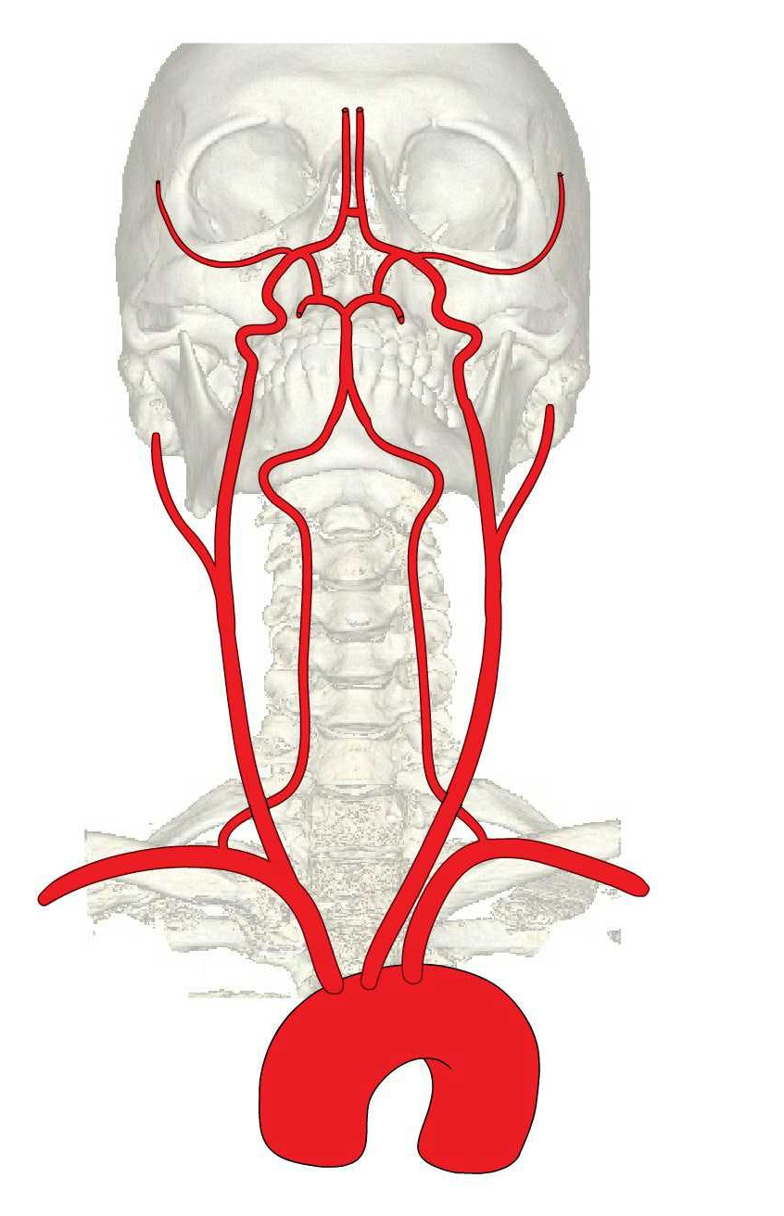
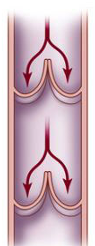
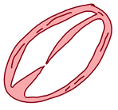
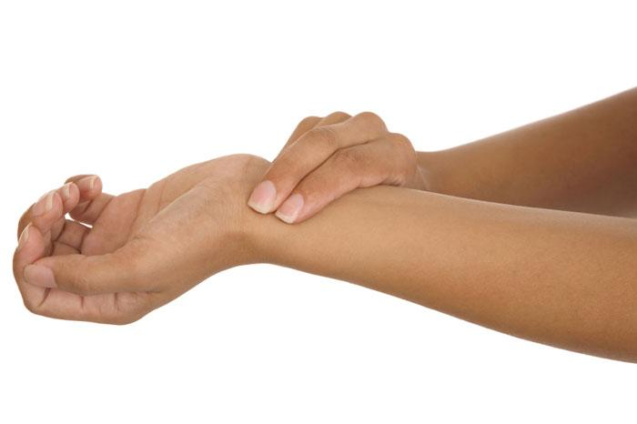
INSTRUCTIONS: All the images in GROUP 1 represent a certain thing. All the images in GROUP 2 represent a different thing. Observe the images in each group and try to identify mystery thing each group represents.
GROUP 1 | GROUP 2
Usually
dark red or blue
High
pressure
Low pressure
Away from heart
Towards heart
Vena cava
Thick, elastic walls
Usually
bright red
Aorta
Thin, inelastic walls

Slide 3
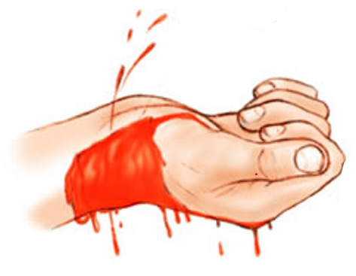
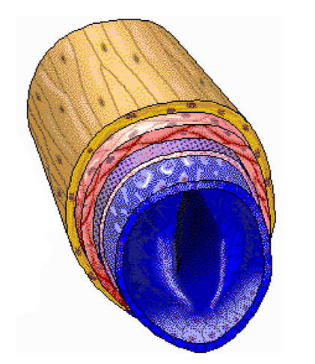
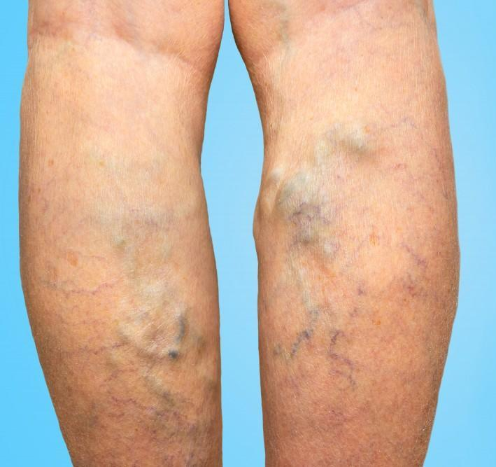
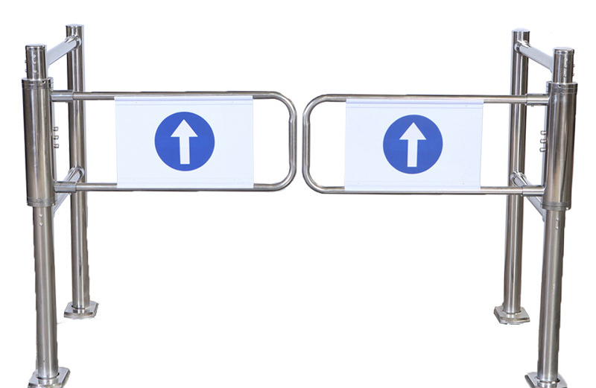
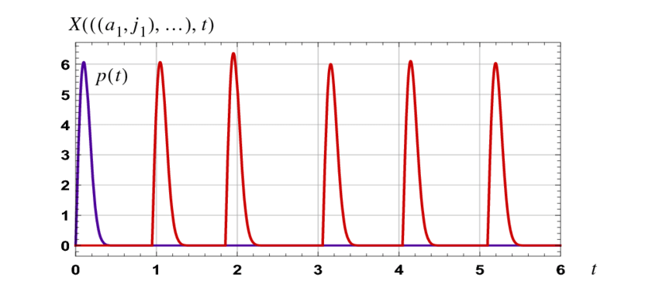
TEST YOUR THEORY: Sort these items into the GROUP 1 and GROUP 2 columns.
GROUP 1 | GROUP 2

Slide 4
FINAL ANSWER: What does GROUP 1 represent? What does GROUP 2 represent?
GROUP 1 | GROUP 2
ARTERIES
VEINS

Slide 5
The materials provided in this resource are for educational purposes only. This material has been reproduced and communicated in accordance with fair use for nonprofit educational purposes. Any further reproduction or communication of this material by you may be the subject of copyright protection.

