Slide 1
Heart Dissection
Body Systems

Slide 2

Before you start:
Watch “What’s Inside a Heart” by We The Curious
WATCH NOW!

Slide 3
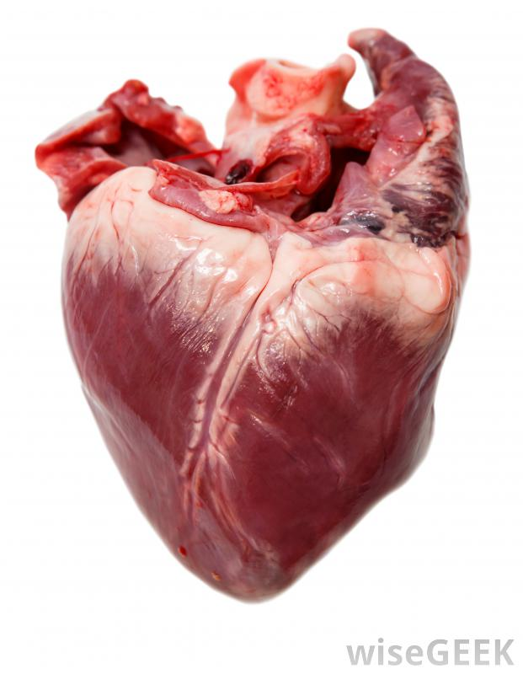
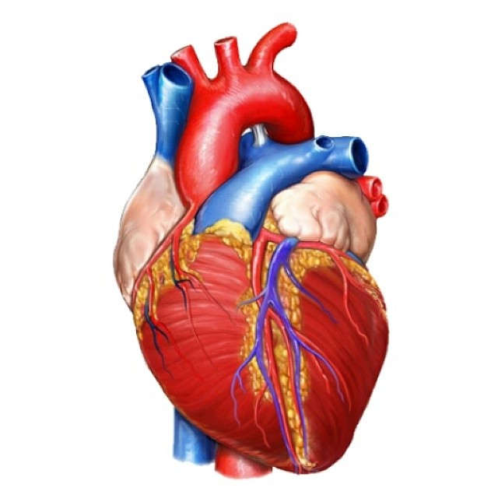
STEP 1: Identify the left & right sides
Right
Left
Right
Left

Slide 4
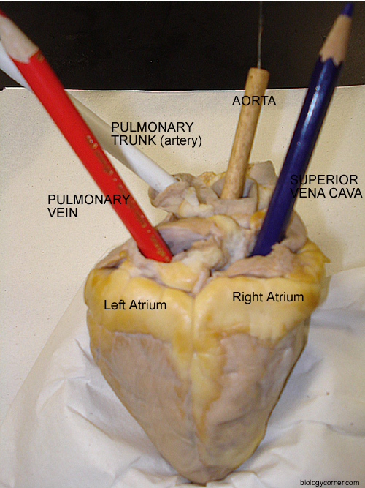
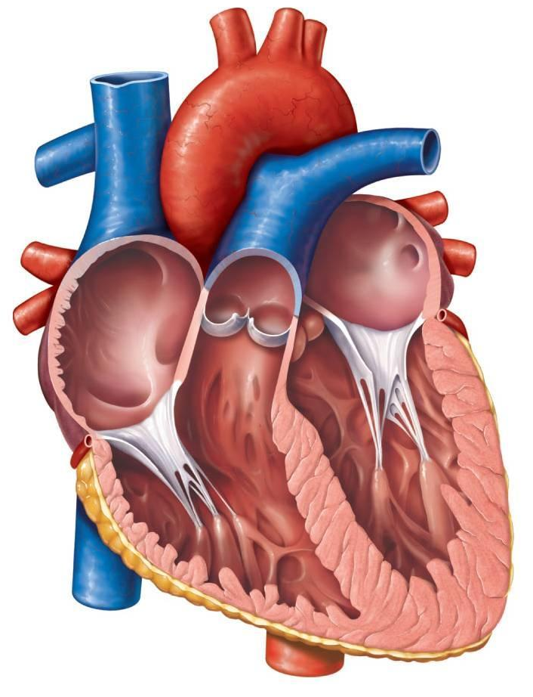
STEP 2: Identifying the major vessels
Pulmonary artery
Superior vena cava
Aorta
Pulmonary artery
Aorta
Pulmonary vein
Superior vena cava
R-atrium
L-atrium
Pulmonary vein

Slide 5
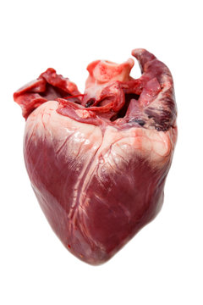
STEP 3: Identifying the four chambers (external)
R-atrium
L-atrium
R-atrium
L-atrium
R-ventricle
L-ventricle
R-ventricle
L-ventricle

Slide 6
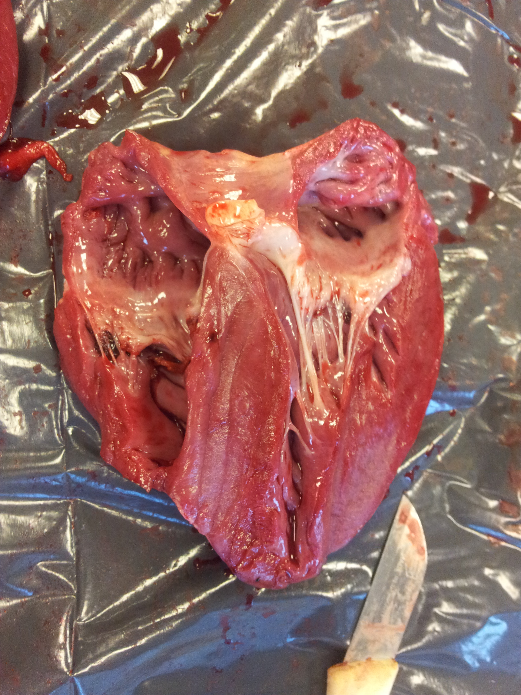
STEP 4: Identifying the four chambers (internal)
R-atrium
L-atrium
R-atrium
L-atrium
R-ventricle
L-ventricle
R-ventricle
L-ventricle

Slide 7
TASK 5: Identifying the values & heart strings
Valve
Valve
Valve
Valve
Heart strings
Heart strings
Heart strings
Heart strings

Slide 8
The materials provided in this resource are for educational purposes only. This material has been reproduced and communicated in accordance with fair use for nonprofit educational purposes. Any further reproduction or communication of this material by you may be the subject of copyright protection.

